Slide 1
Centrality-Based Number of Cluster Estimation (CB-NCE) algorithm.

Slide 2
Problem Statement:
Graph clustering is the process of grouping nodes in a graph such that nodes within the same group (cluster) are more similar to each other than to nodes in different clusters. One of the primary challenges in graph clustering is determining the correct number of clusters. This is crucial because different applications might have varying numbers of underlying clusters, and using an incorrect number of clusters can lead to inaccurate results.

Slide 3
problem solution
Step 1: Centrality Measure Calculation:
In graph theory, centrality measures quantify the importance or influence of nodes within a graph. The CB-NCE algorithm utilizes centrality measures to estimate the correct number of clusters in a graph.
The algorithm considers three types of centrality measures: degree centrality, eigenvector centrality, and closeness centrality. These measures help identify the most important nodes in the graph.
and calculate it using this equation :
(Centrality(node_idx) = Σ(adjacencyMatrix[node_idx]))
Step 2: Cluster Generation:
The algorithm starts by generating clusters of nodes with varying numbers of clusters (K) from a specified range (Kmin to Kmax).

Slide 4
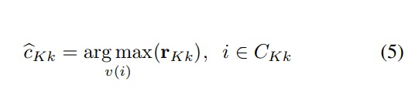
Step 3: Cluster Center Determination:
For each cluster (CKk), the algorithm identifies the node with the highest centrality as the estimated center of that cluster.
In cases where multiple nodes have the same highest centrality, a new central node is virtually introduced and connected to the node with the highest centrality.
rkk: The centrality vector for kth cluster when the total number of the clusters is K.
CKk: kth graph cluster when the total number of clusters is K.

Slide 5

Step 4: Cluster Compactness Calculation:
The algorithm calculates the cluster compactness (yKk) for each cluster CKk. Cluster compactness measures how close the nodes in a cluster are to their estimated center.
ykk:cluster compactness
square[d(vKk(i), cˆvKk(i))]:is the square of the distance the node and its estimated center.
vKk(i): indicates that the node v(i) belongs to cluster k when the total number of the clusters is K.
CKk: kth graph cluster when the total number of clusters is K.

Slide 6


Step 5: Total Cluster Compactness:
The total cluster compactness (yK) is computed by averaging the cluster compactness values for all clusters CKk.
this is the average of the cluster compactness.
Step 6: Variance Calculation:
The algorithm calculates the variance (σ^2_Kk) for each cluster CKk based on the scatteredness of nodes around their estimated cluster center.
(σ^2_Kk): the variance
d(vKk(i), cˆvKk(i)): the distance between the node and its estimated center.

Slide 7

Step 7: Average Central Error (ACE) Calculation:
ACE (zK) is calculated as the error between the true center of a node and its estimated center for each cluster CKk. It's computed by summing the squared distances of nodes from their estimated cluster centers.
zkk: the error between the true center of a node and its estimated center
zk:the average of summing the squared distances of nodes from their estimated cluster centers.

Slide 8

Step 8: Noiseless Description Length:
The algorithm converts the ACE into a noiseless description length (MNDL) based on the cluster compactness and a constant γ. MNDL represents a measure of the optimal number of clusters that minimizes the error.
MNDL:is equivalent to minimizing the noiseless description
length of the nodes in the graph clusters

Slide 9

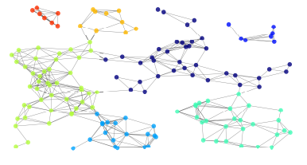
Step 9: Optimal Number of Clusters Estimation:
The algorithm iterates through the range of possible cluster numbers (K) and selects the number of clusters (Kˆ) that corresponds to the minimum noiseless description length (MNDL).
K ∈ [Kmin, Kmax].
Step 10: Clustering Solution:
The algorithm determines the final clusters based on the estimated optimal number of clusters (Kˆ). Each node is assigned to the cluster where its estimated center resides.

Slide 10
Conclusion:
The CB-NCE algorithm provides a method to estimate the optimal number of clusters in graph clustering by utilizing centrality measures and minimizing the average central error. By following these steps, the algorithm identifies the correct number of clusters that best capture the underlying structure of the data in the graph.
our input is the data set and the output will be the optimal number of the cluster that used for the graphing cluster.

